Slide 1
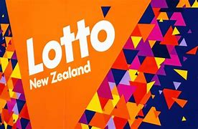
PowerPoint Infographics Sampler
New Zealand
Lotto
Result Analysis
STATISTICS

Slide 2
Content
Lotto New Zealand
Data Set
Lotto Result Analysis
Q&A
Conclusion

Slide 3
Lotto New Zealand - Introduction
Lotto Overview
Lotto New Zealand is a popular lottery game established in 1987, offering players the chance to win substantial amount of money through a simple number selection process
Game Structure
Players select 6 numbers from a pool of 40.
Draws are held weekly on Wednesdays and Saturdays.

Slide 4
Lotto New Zealand - Purpose
What are the optimal numbers to pick?
Which numbers are drawn most frequently?
Are there any patterns to these numbers?

Slide 5
Data Set
Data Set used is created by Lottolyzer.
Data provided is from 2008 when they implemented new drafting methods
Some old data contained empty cells and were cleaned up.
Data was transformed and converted to make sure only relevant information are shown.

Slide 6
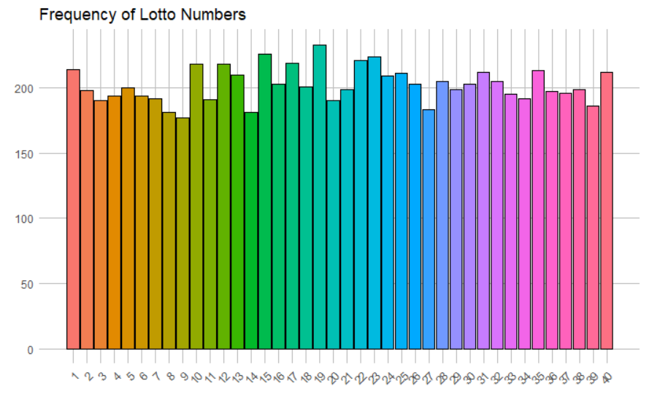
Lotto Result Analysis
Which numbers are drawn most frequently?
Most Frequently Drawn Numbers
19: drawn 233 times
15: drawn 226 times
23: drawn 224 times
22: drawn 221 times
17: drawn 219 times
10: drawn 218 times

Slide 7
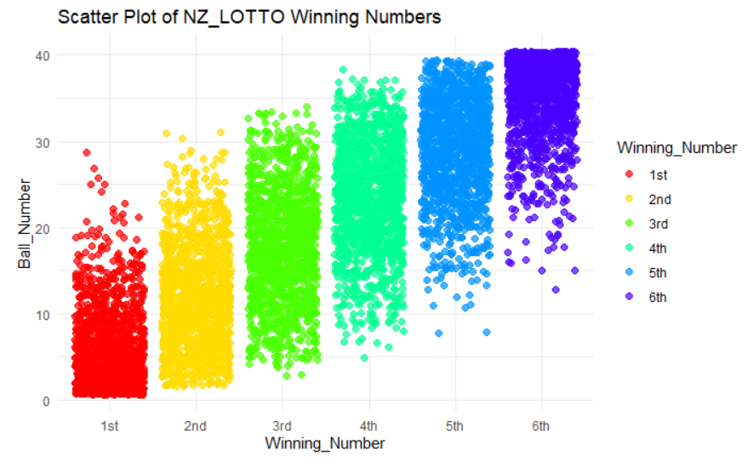
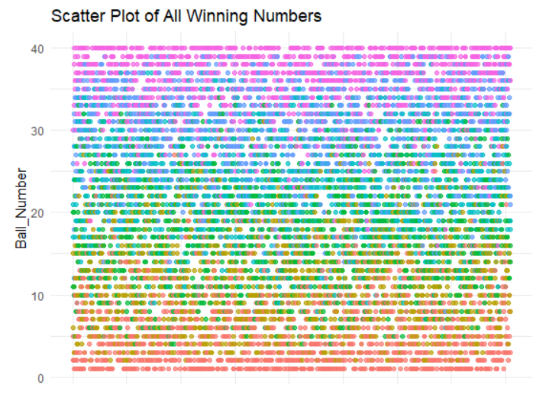
Lotto Result Analysis
Are there any patterns to these numbers?

Slide 8
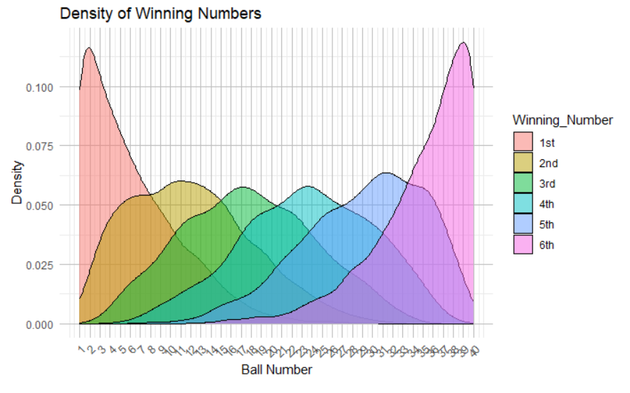
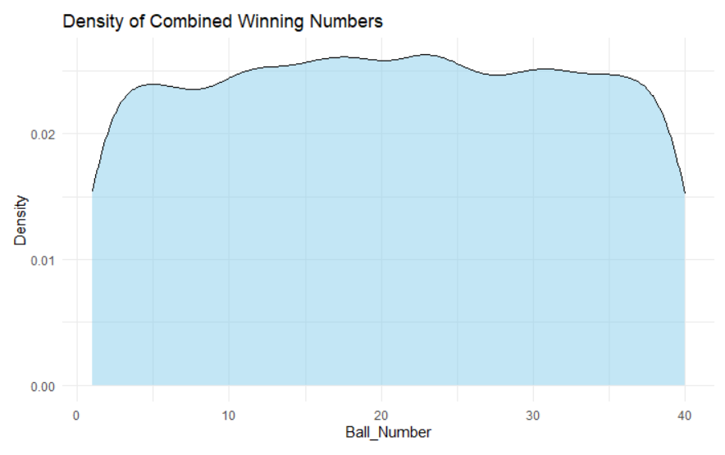
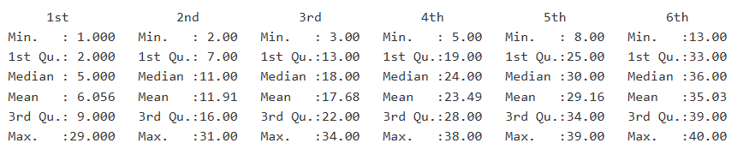
Lotto Result Analysis
Are there any patterns to these numbers?

Slide 9
Conclusion
There are no optimal numbers to increase your odds of winning.
We can use historic data as evidence to distribute the lottery numbers evenly from 1 to 40.
We are also able to use historic data as evidence to find the most frequently drawn numbers.
Numbers chosen based on educated guess using historic data as evidence are 6, 11, 17, 23, 29, 35

Slide 10

Q & A

